Slide 1
DevOps Academy – Week 1
DevOps Mindset

Slide 2
Day 4
DevOps Approach

Slide 3
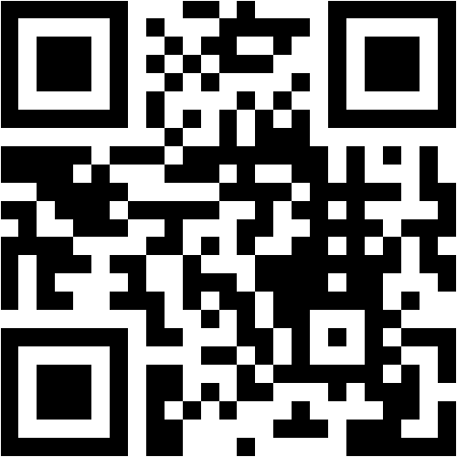
Vorstellungsrunde - menti.com/84scvibzbs (go to menti.com and use the code: 31 24 6)

Slide 4


Slide 5
“Currently, DevOps is more like a philosophical movement, not yet a precise collection of practices, descriptive or prescriptive.”
- Gene Kim, 2015

Slide 6
Plan
Design
Code
Build
Verify
Release
Deploy
Operate
Monitor

Slide 7
Plan
Design
Code
Build
Verify
Release
Deploy
Operate
Monitor

Slide 8
Plan
Design
Code
Build
Verify
Release
Deploy
Operate
Monitor

Slide 9
Day 4: DevOps Approach - Learning Outcomes Als Consultant kann ich…
Den gesamten DevOps Infinity Loop und seine einzelnen Phasen erklären
Gängige DevOps Vorgehensweisen verstehen & anwenden

Slide 10
DevOps „You build it – You run it“

Slide 11
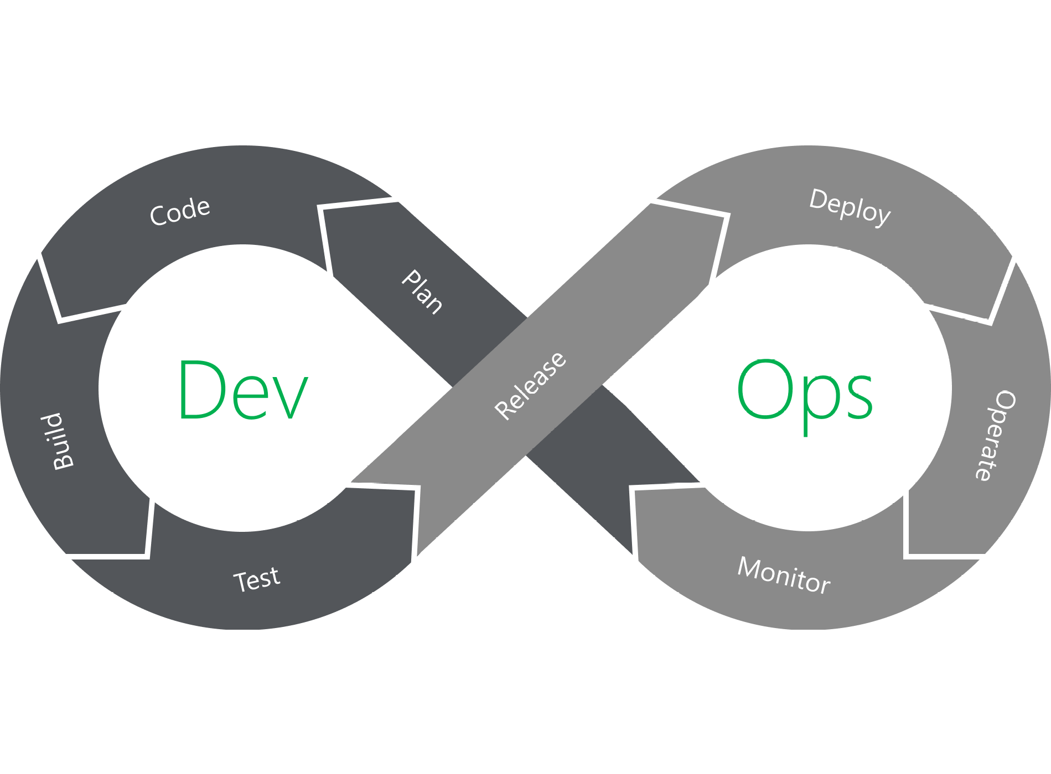

Slide 12
Division of Labour
C-Level
Mgmt
Mgmt
Mgmt
Requirement & Design
Development & Testing
Operation & Support
AGILE
DevOps
Biz
Dev
Ops

Slide 13
Conflict of Interest
C-Level
Mgmt
Mgmt
Mgmt
Requirement & Design
Development & Testing
Operation & Support
Biz
Dev
Ops
Masterpiece Mentality
Deliver Mindset
Stability Mindset

Slide 14
DevOps Workshop – 5 Groups
Recherchiert pro Gruppe die einzelnen Punkte hinter dem CALMS-Framework:
Culture
Automation
Lean
Measurement
Sharing
Präsentiert je 5 min
medium.com/cofinpro/keep-calms-start-devops-60178cd5723e
atlassian.com/devops

Slide 15


Slide 16
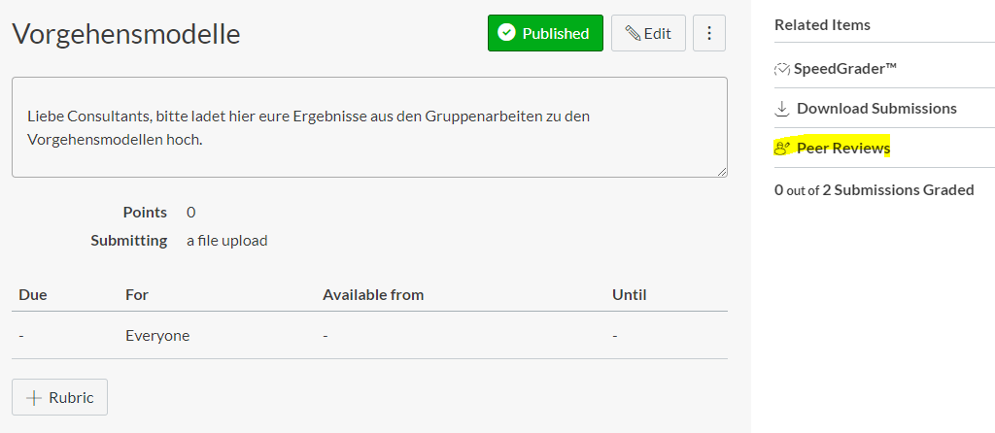

Slide 17
IT Organisation

Slide 18
Operations – Classic IT
CIO
Mgmt
Network & Telco
Application Management
Helpdesk & 2nd-Level
Release Management
Infrastructure
Monitoring & Alerting

Slide 19
Operations – DevOps
CIO
Mgmt
Helpdesk, Network & Telco
Application Management
2nd-Level & 3rd-Level
Orchestration
Release Management
Infrastructure
Monitoring & Alerting
CI/CD
PaaS

Slide 20
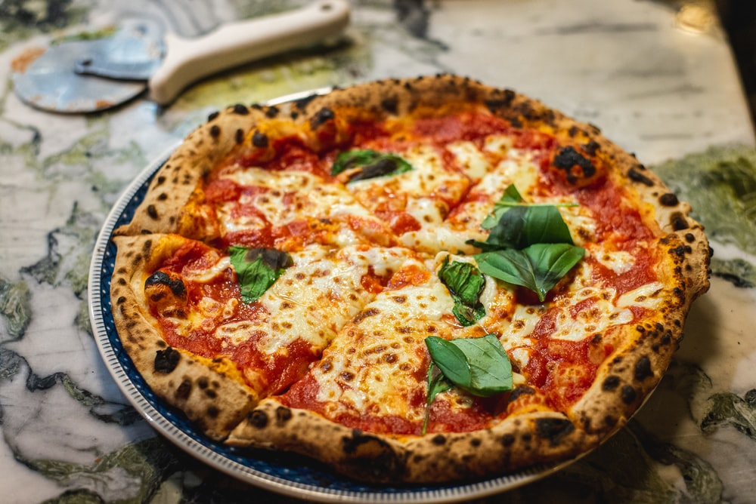

Slide 21
DevOps Paper Pizza – 3 Groups
A traditional service team
1 Customer – Phone [Patio]
1 Call Center Agent - Phone & Email [Lounge]
1 2nd-Level Support Agent – Email [Lounge]
1 Product Manager - Email & Watch
1 Designer - Pen & Paper
1 Developer - Paper, Marker, Scissors, Glue
1 Tester
1 Operator - Shovel
2 agile DevOps teams
1 Customer – Phone [Patio]
1 Call Center Agent - Phone & Email [Lounge]
1 DevOps-Engineer - Phone, Email, Pen, Paper, Marker, Scissors, Glue, Shovel
1 Scrum Master - Watch
www.agile42.com/en/kanban-pizza-game/

Slide 22
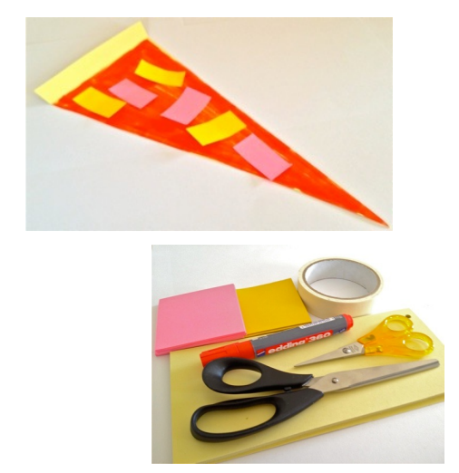
DevOps Paper Pizza – 3 Groups
Regeln
Stick to your Card
Sauce = Marker
Topping = Cut from Stickies
Pizza Quality:
Cut > Ripped
Geometric > Ungeometric
www.agile42.com/en/kanban-pizza-game/

Slide 24
Softwareverifizierung

Slide 25
Verify is directly associated with ensuring the quality of the software release; activities designed to ensure code quality is maintained and the highest quality is deployed to production
- Wikipedia, 2020

Slide 26
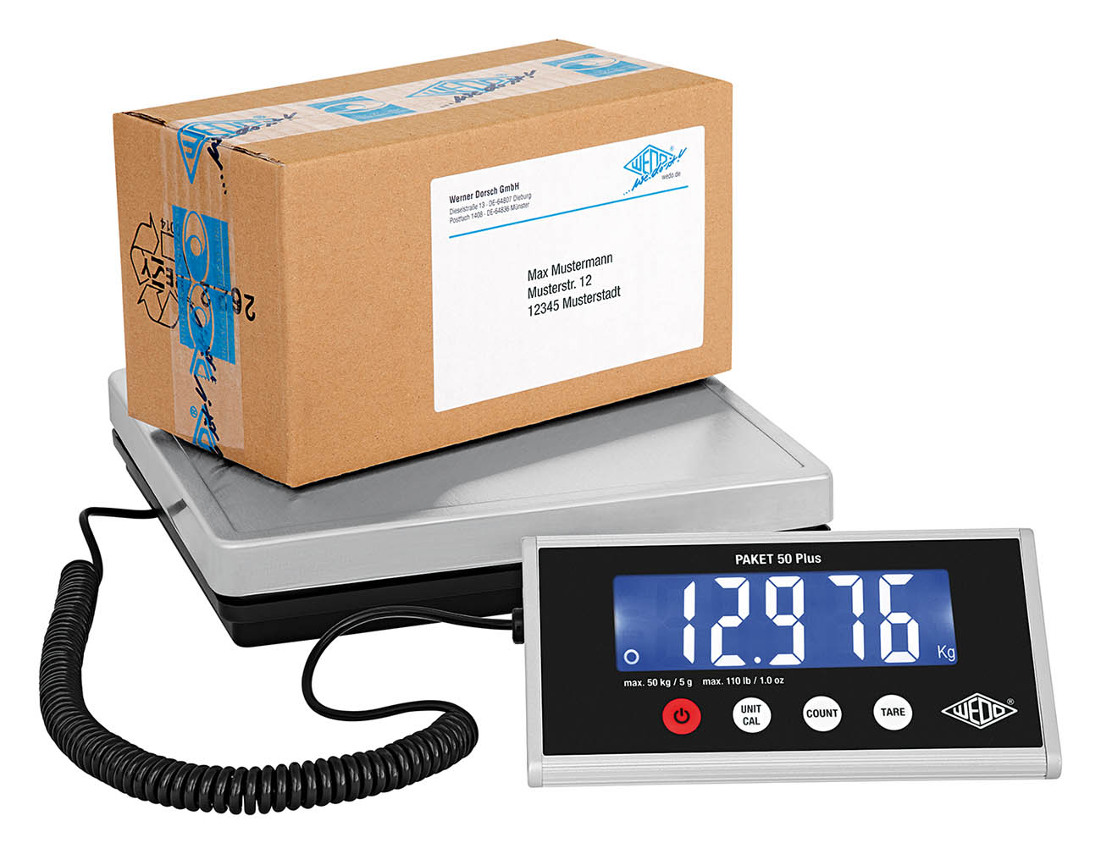

Slide 27
Softwareverifizierung - Bereiche
Code Quality
Code Coverage
Unit Testing
Integration Testing
User Acceptance Testing
Performance & Load Testing

Slide 28


Slide 29
Monitoring

Slide 30
Monitoring is an important link in a DevOps toolchain. It allows IT organization to identify specific issues of specific releases and to understand the impact on end-users.
- Wikipedia, 2020

Slide 31


Slide 32
Monitoring - Bereiche
Infrastructure
Network
Dependencies
Application
Business KPIs
Performance

Slide 33
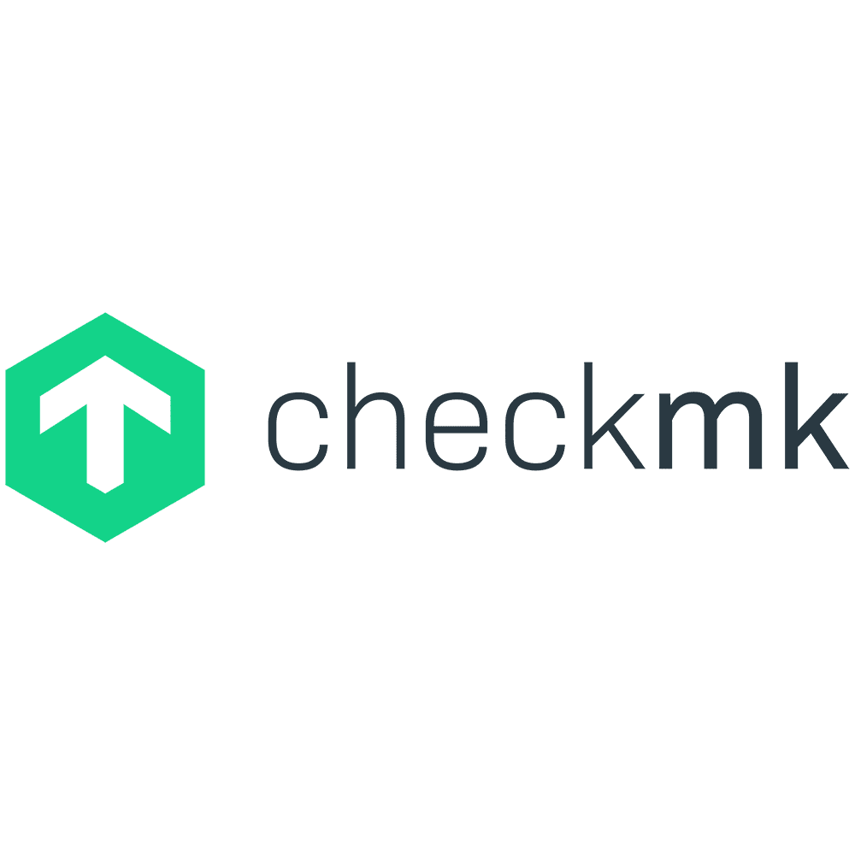

Slide 35
DevOps Miniprojekt: Sonarqube Code Verification – 5 Groups
Als Kunde möchte ich, dass mein Projekt mit statischer Codeverifizierung überprüft & Per Zustandsüberprüfung überwacht wird, damit hohe Qualität und Verfügbarkeit garantiert werden kann.
Wählt ein Vorgehensmodell und plant euer Miniprojekt
Wählt eine Softwareentwurf-Methode und designed euer Miniprojekt
Verwendet Sonarqube, checkmk und Maven zum verifizieren eines Projekts
Präsentiert in 10 min eure Lösung
Bonus: Sonarqube zeigt keine Fehler mehr an
Bonus-Bonus: Monitoring informiert Bereitschaft
hub.docker.com/_/sonarqube/
docs.sonarqube.org/latest/analysis/scan/sonarscanner-for-maven/
docs.sonarqube.org/latest/setup/get-started-2-minutes/
checkmk.de/cms_introduction_docker.html
checkmk.de/cms_intro.html

Slide 36
Plan
Design
Code
Build
Verify
Release
Deploy
Operate
Monitor

Slide 37


Slide 38
End of Day 4
DevOps Approach

Slide 40
Customer
„You are hungry for a delicious pizza. So you call the paper pizza call center. You can choose any pizza you like: hawaii, diavolo, caprese, …“
Tasks
Call call-center agent
Call again in 5min with changes
Restrictions
You can only call the call-center agent
Call-Center Agent
„You take calls from all customers and write down their order. While on the call you can ask anything.“
Tasks
Give the customer your number
Take notes
Write an email to 2nd-Level
Restrictions
You can only reach 2nd-Level by email
2nd-Level Support
„You get emails from call-center agents and inform product management about the new requirements“
Tasks
Give the call-center agent your email adress
Wait for email
Write an email to the PM
Restrictions
You can only email the call-center agent and the PM

Slide 41
Product Manager
„You are the one responsible for all pizza deliveries and give orders to the designers which requirements to design next.“
Tasks
Stop the time call to delivery
Give your email to 2nd-level
Talk to the designer
Ask repeatedly about the progress
Restrictions
You can‘t talk to customers
Pizza Designer
„You are the artist here. You design every pizza layout by hand and tell the developer what to put where.“
Tasks
Create pizza template
Give it to developer & tester
Explain them what the customer wants
Restrictions
You can only talk to the developer, tester and PM
Pizza Developer
„You‘re the one who does the actual work. Putting together the pizza piece by piece. But you are not allowed to put it in the oven“
Tasks
Create a pizza that fulfills the design template
Hand it over to the tester
Restrictions
You can only talk to the designer and tester

Slide 42
Pizza Tester
„Your are the one who makes sure the pizza is good for delivery. You check if it fits the design template to a 100%“
Tasks
Compare pizza to design
If OK give the pizza to operator
If not OK tell developer
Restrictions
You can only talk to the developer and operator
Pizza Operator
„You are the only one who is allowed to operate the pizza paper oven and delivers pizzas to customers.“
Tasks
Take the pizza and put it in the oven
Wait 60 seconds
Deliver the pizza to the customer
Restrictions
You can only talk to tester and customer

Slide 43
Customer
„You are hungry for a delicious pizza. So you call the paper pizza call center. You can choose any pizza you like: hawaii, diavolo, caprese, …“
Tasks
Call call-center agent
Call again in 5min with changes
Restrictions
You can only call the call-center agent
Call-Center Agent
„You make sure all customers are satisfied and do everything you can that they get the right order.“
Tasks
Give the customer your number
Make sure the wishes of the customer reach DevOps
Restrictions
none

Slide 44
Scrum Master
„You are the one trying to reduce impediments in the work process and make sure that everyone has the tools they need to do the work.“
Tasks
Stop the time call to delivery
Observe if there are issues and try to solve them
Ask if you can help
Restrictions
You can‘t do the actual work
Pizza DevOps
„You are the one who takes ownership for the product. Your goal is to satisfy the customer fast with the pizza he wants.“
Tasks
Give your phone and email to the call-center agent
Create the pizza, put it in the oven for 60 sec & deliver it to the customer
Restrictions
none

